Slide 1
HIRES
Technical concept and design

Slide 2
HIRES requirements/goals
HR
Full λ-coverage (0.35-2.5μm) in a single exposure
RV-optimized, ultra-stable HR mode R~100,000
Throughput-optimized HR mode R~100,000
Polarimetric capabilities
Others
Throughput-optimized MR mode R~10,000
Some multi-objects capabilities in MR
Diffraction limited IFU/slit with R~100,000 at IR λ’s

Slide 3
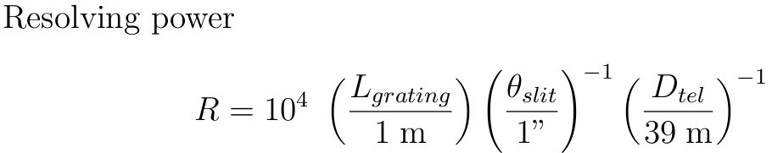
HIRES basic physics of ELTs
Adaptive optics do not help much below 1.2 μm, and are virtually useless below 1 μm
→ HIRES must be designed for seeing limited PSF
Cannot make a instrument with a grating of ~10m
→ HIRES cannot be a genuine, HR-optimized spectrometer
  HIRES is intrinsically a MR-optimized spectrograph
  To obtain HR one needs a long-slit and a slicer

Slide 4
HIRES main HR-RV observing mode
Mode | R | D-fib | N.obj | Size of Res. Element |  | Comment
 |  |  |  | on-sky | pixels
HR-RV | 100,000 | 0.76” | 2 + λ_{cal} | 0.127” x 5.0” | 2.8 x 63 | 1x6 slicing, optimized for RV (scramble etc.)
HR-HT | 100,000 | 0.76” | 2 (+λ_{cal}) | 0.127” x 5.0” | 2.8 x 63 | 1x6 slicing, optimized for throughput
MR MOS | 14,500 | 0.86” | 10 | 0.86” x 0.86” | 20 x 11 | MOS on ELT 10’ fov
HR² IFU | 80,000 | 7mas | 35 | 7mas x 7mas | 3.5 x 2 | SCAO fov 35x49 mas

Slide 5
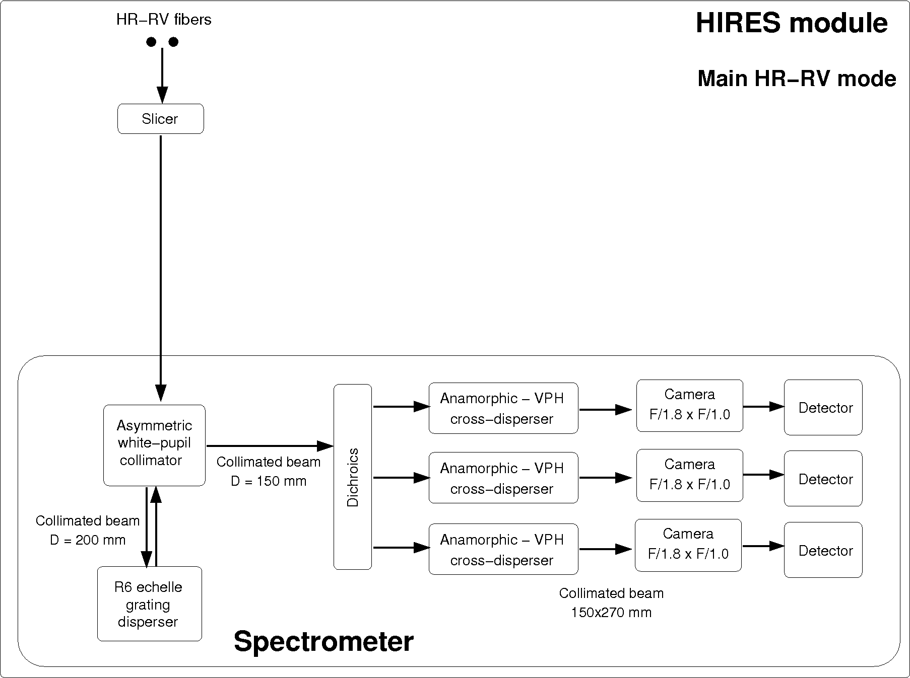
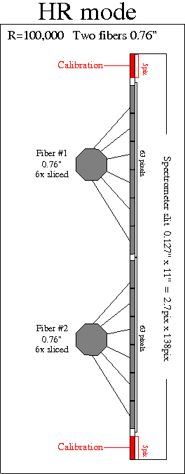
HIRES main HR-RV observing mode
Illumination of input slit

Slide 6
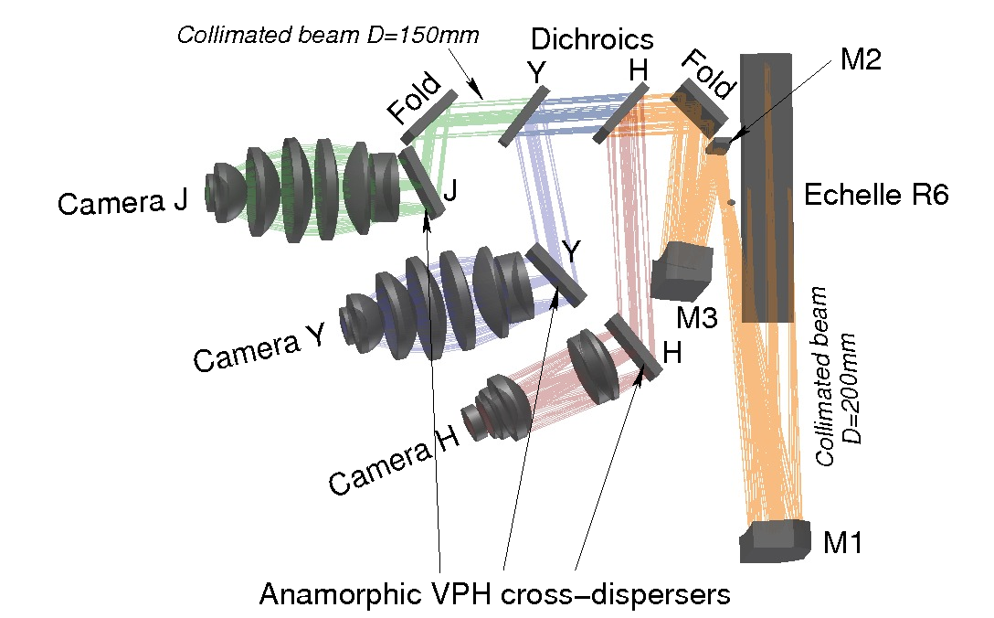
HIRES main HR-RV observing mode
3D layout and rays tracing of HIRES-YHJ spectrometer

Slide 7
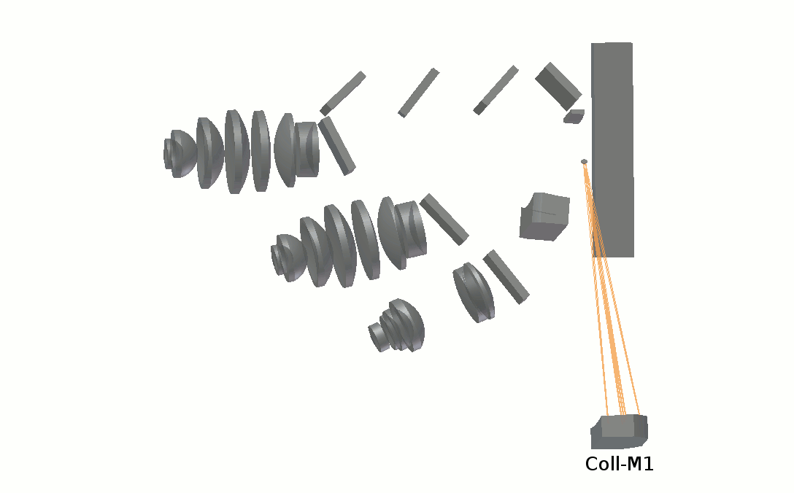
HIRES main HR-RV observing mode
3D layout and rays trace animation of HIRES-YHJ spectrometer

Slide 8
HIRES main HR-RV observing mode
Comparison with other HR spectrographs
Parameter | HIRES | CODEX | Espresso
# Fibers | 2 | 2 | 2
D-fiber | 0.76” | 0.82” | 1”
Simultaneous λ_{cal} | Always | Use sky fiber | Use sky fiber
Spectra of fibers 1,2 | On same detector | On different CCDs | On same detector
Echelle length | 1.2m | 1.6m | 1.2m
F/n of cameras⁽¹⁾ | F/1.0 | F/1.4 | F/1.8
# of reflections⁽²⁾ | 7 | 11 | 6
# of refr. elements ⁽²⁾ | 9 | 8 | 7
In the cross-dispersion direction
Refers to the optical elements of the spectrometer

Slide 9
HIRES other observing modes
Mode | R | D-fib | N.obj | Size of Res. Element |  | Comment
 |  |  |  | sky | pixels
HR-RV | 100,000 | 0.76” | 2 + λ_{cal} | 0.127” x 5.0” | 2.8 x 63 | 1x6 slicing, optimized for RV (scramble etc.)
HR-HT | 100,000 | 0.76” | 2 (+λ_{cal}) | 0.127” x 5.0” | 2.8 x 63 | 1x6 slicing, optimized for throughput
MR MOS | 14,500 | 0.86” | 10 | 0.86” x 0.86” | 20 x 11 | MOS on ELT 10’ fov
HR² IFU | 80,000 | 7mas | 35 | 7mas x 7mas | 3.5 x 2 | SCAO fov 35x49 mas

Slide 10
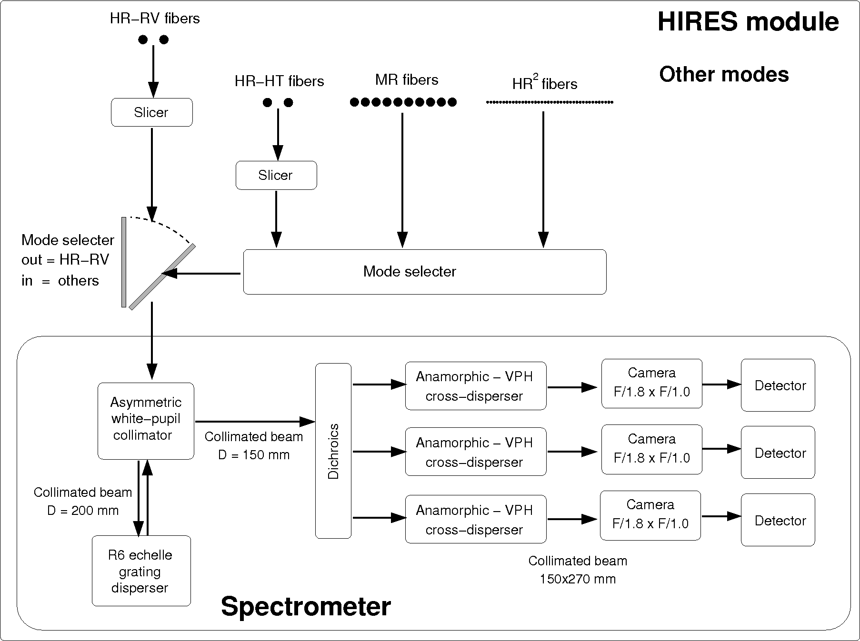
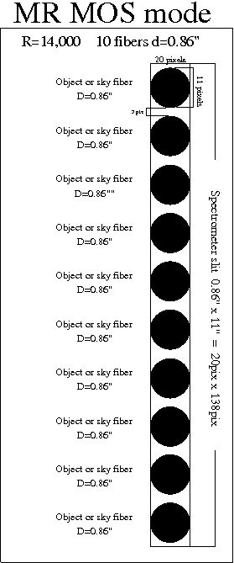
HIRES other observing mode
Illumination of input slit

Slide 11
HIRES modes-switch does not affect main mode

Slide 12
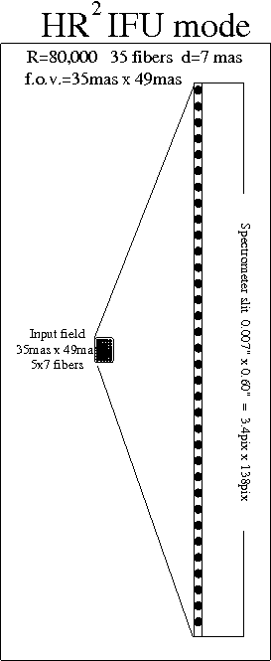
HIRES observing modes

Slide 13
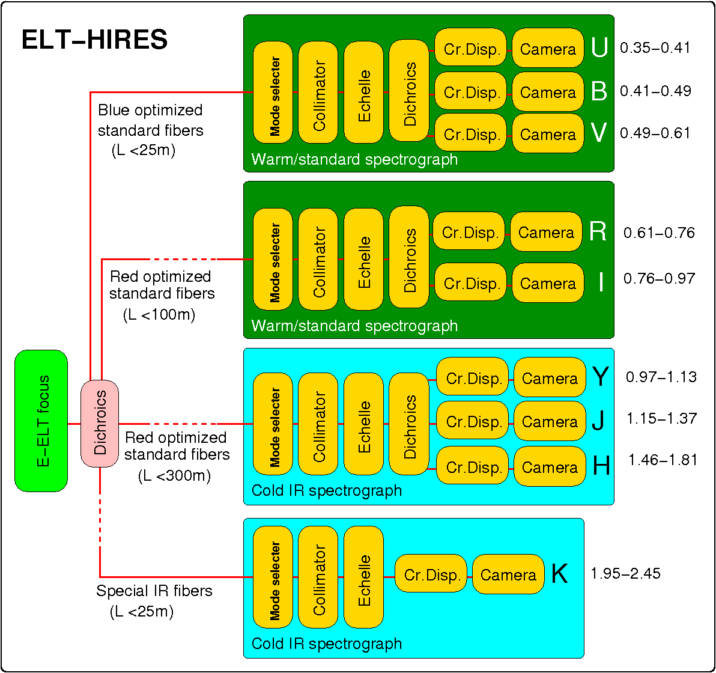
HIRES modular instrument scheme
We just described this part

Slide 14
HIRES modular instrument scheme
4 independent spectrographs fed by 4 groups of fibers
Each spectrograph/fiber sees a different λ-range
Each fiber is fed through dichroics with separate ADC’s to correct atmospheric dispersion
Interface to K-fiber is cooled and includes a cold-stop, while does not have an ADC
In the medium-resolution mode there are 10 groups of fibers (i.e. 10 fiber interfaces) each looking at a different object, i.e. it is a MOS mode

Slide 15
HIRES: fibers interface and positioner
This part

Slide 16
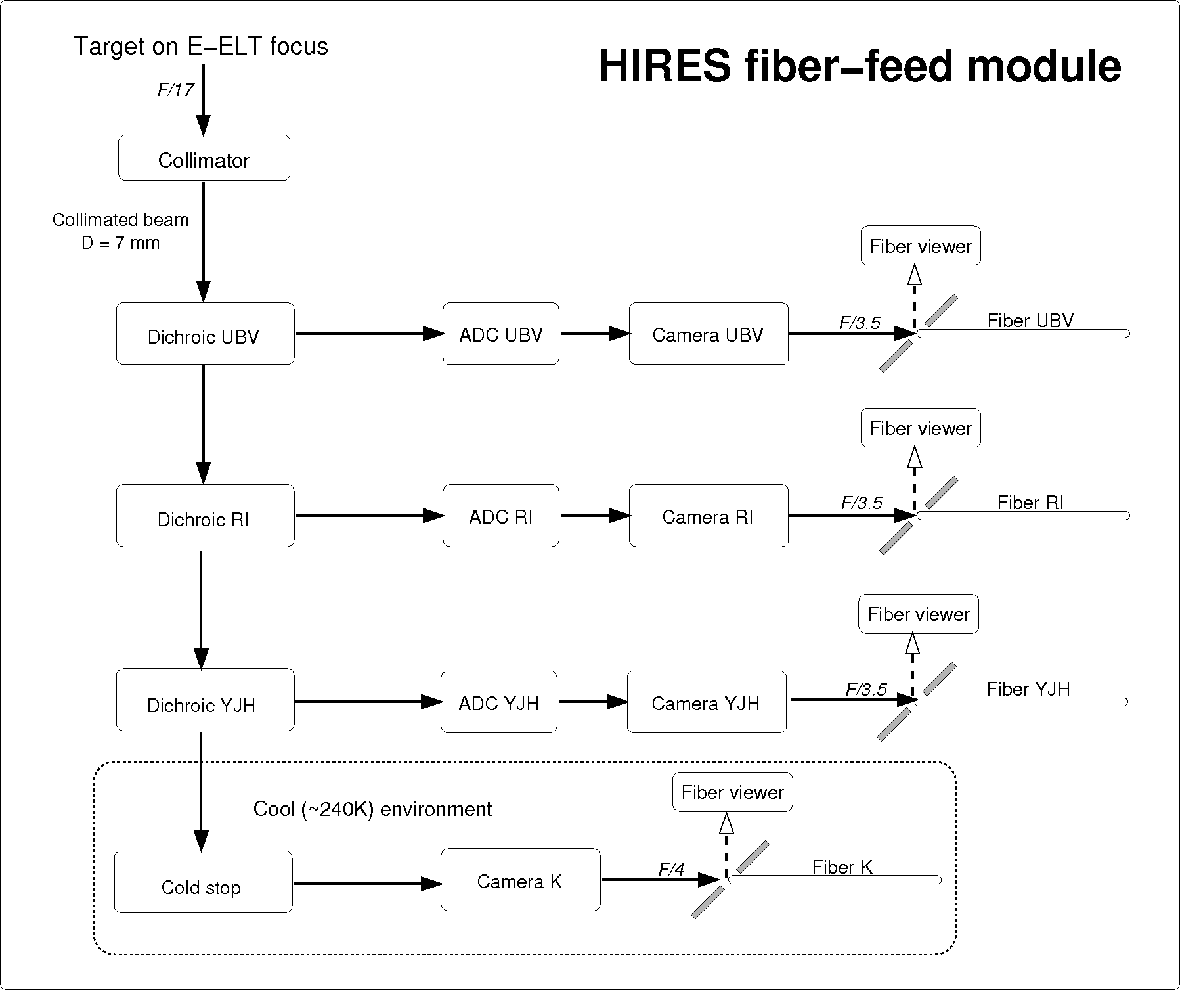
HIRES: fibers interface and positioner
4 fibers looking at the same object

Slide 17
HIRES: fibers interface and positioner
4 spectrographs fed by 4 group of fibers
Each spectrograph/fiber sees a different λ-range
Each fiber is fed through dichroics with separate ADC’s to correct atmospheric dispersion
Interface to K-fiber is cooled and includes a cold-stop, while does not need an ADC
In the medium-resolution mode there are 10 groups of fibers (i.e. 10 fiber interfaces) each looking at a different object, i.e. it is a MOS mode

Slide 18
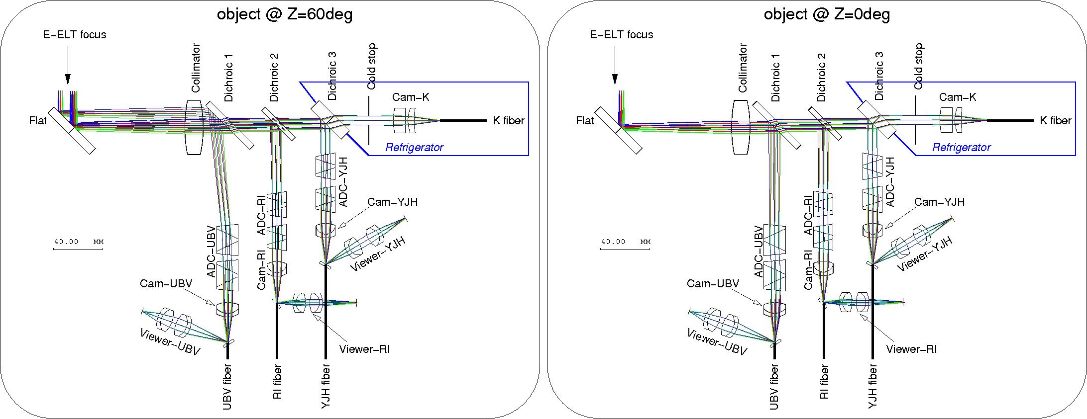
HIRES: fibers interface and positioner
U-K atmospheric dispersion =2” @45º → ADC fundamental
2” corresponds to 6mm (!!) on E-ELT focal plane
Optical layout and rays-tracing for different zenith angles

Slide 19
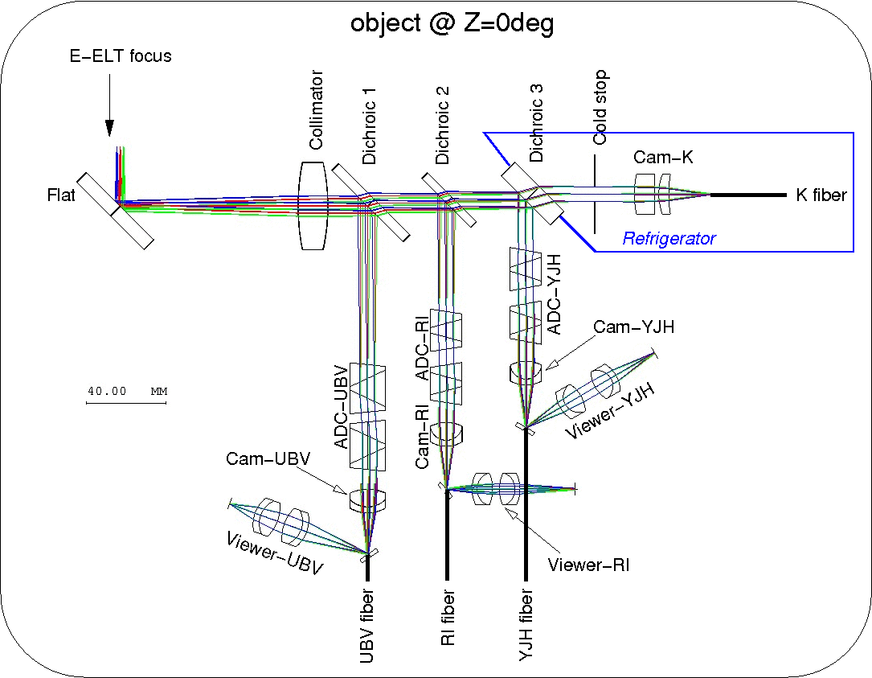
ELT = Extremely Large effect of aTmospheric dispersion..
…ELT-MOS instruments do not foresee ADC’s !!

Slide 20
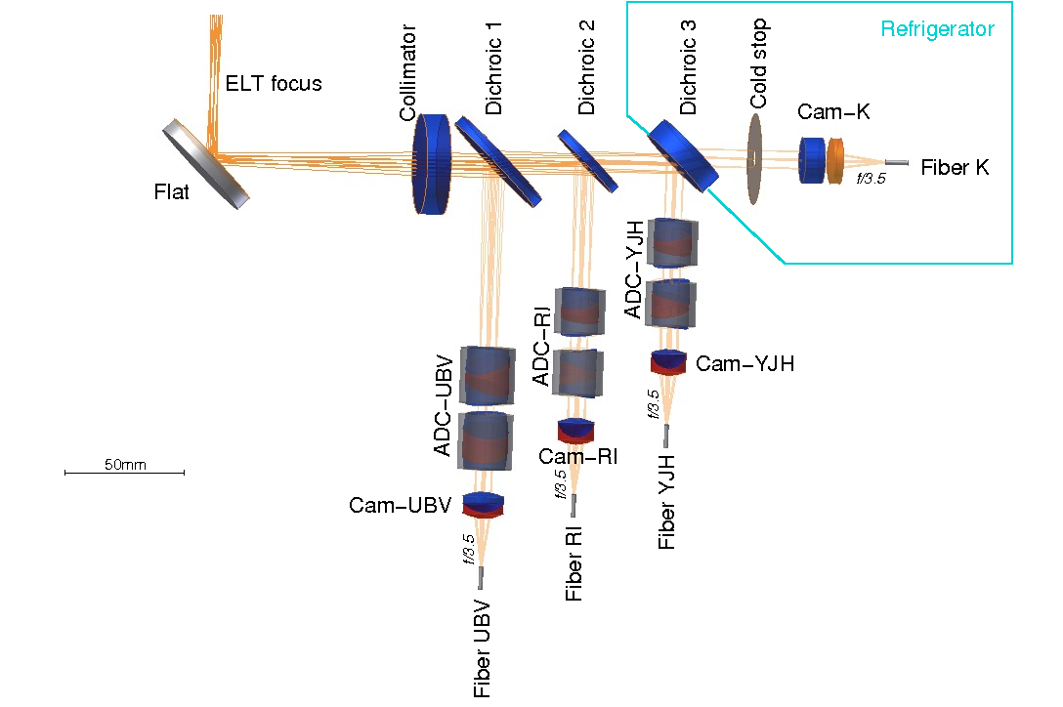
HIRES: fibers interface and positioner
3D layout with rays-tracing at z=0º
D_{fiber}(HR) = 0.50mm
D_{fiber}(MR)= 0.57mm

Slide 21
HIRES: fibers interface and positioner
4 spectrographs fed by 4 group of fibers
Each spectrograph/fiber sees a different λ-range
Each fiber is fed through dichroics with separate ADC’s to correct atmospheric dispersion
Interface to K-fiber is cooled and includes a cold-stop, while does not have an ADC
In the medium-resolution mode there are 10 groups of fibers (i.e. 10 fiber interfaces) each looking at a different object, i.e. it is a MOS mode

Slide 22
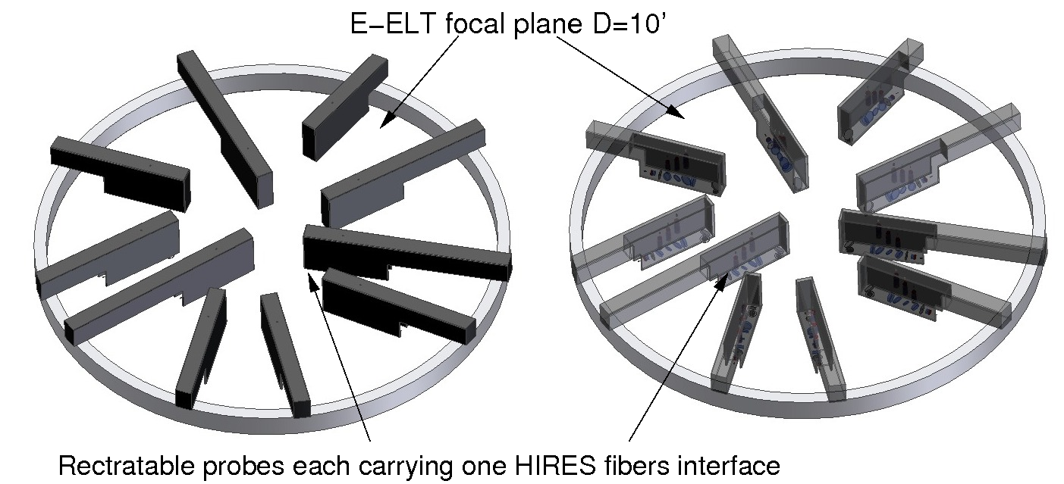
HIRES: fibers interface and positioner
Fiber interface is an A4-size rectangle ~10cm thick
10+ interfaces can be positioned on the Nas-focus

Slide 23
HIRES as a MR spectrometer
Mode | R | D-fib | N.obj | Size of Res. Element |  | Comment
 |  |  |  | sky | pixels
HR-RV | 100,000 | 0.76” | 2 + λ_{cal} | 0.127” x 5.0” | 2.8 x 63 | 1x6 slicing, optimized for RV (scramble etc.)
HR-HT | 100,000 | 0.76” | 2 (+λ_{cal}) | 0.127” x 5.0” | 2.8 x 63 | 1x6 slicing, optimized for throughput
MR MOS | 14,500 | 0.86” | 10 | 0.86” x 0.86” | 20 x 11 | MOS on ELT 10’ fov
HR² IFU | 80,000 | 7mas | 35 | 7mas x 7mas | 3.5 x 2 | SCAO fov 35x49 mas

Slide 24
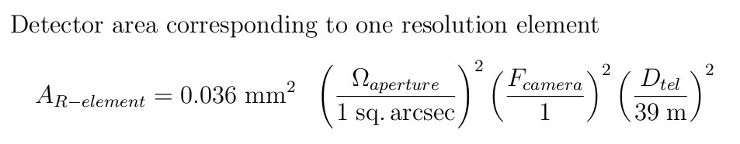
HIRES spectral sampling
MR spectral element on 220 pixels !
Is this really optimized?
… again basic physics of ELTs ...

Slide 25
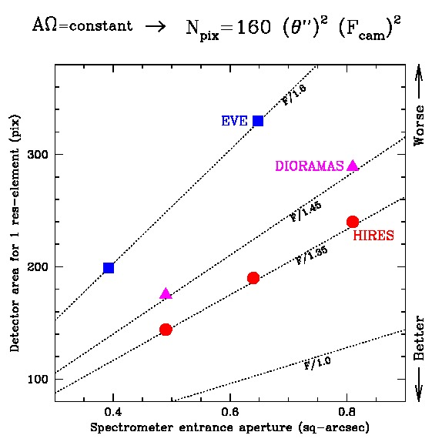
HIRES vs. OPTIMOS

Slide 26
HIRES as an IFU spectrometer
Mode | R | D-fib | N.obj | Size of Res. Element |  | Comment
 |  |  |  | sky | pixels
HR-RV | 100,000 | 0.76” | 2 + λ_{cal} | 0.127” x 5.0” | 2.8 x 63 | 1x6 slicing, optimized for RV (scramble etc.)
HR-HT | 100,000 | 0.76” | 2 (+λ_{cal}) | 0.127” x 5.0” | 2.8 x 63 | 1x6 slicing, optimized for throughput
MR MOS | 14,500 | 0.86” | 10 | 0.86” x 0.86” | 20 x 11 | MOS on ELT 10’ fov
HR² IFU | 80,000 | 7mas | 35 | 7mas x 7mas | 3.5 x 2 | SCAO fov 35x49 mas
A zoom on the central pixel of present IFU’s
at the highest spectral and spatial resolutions

Slide 27
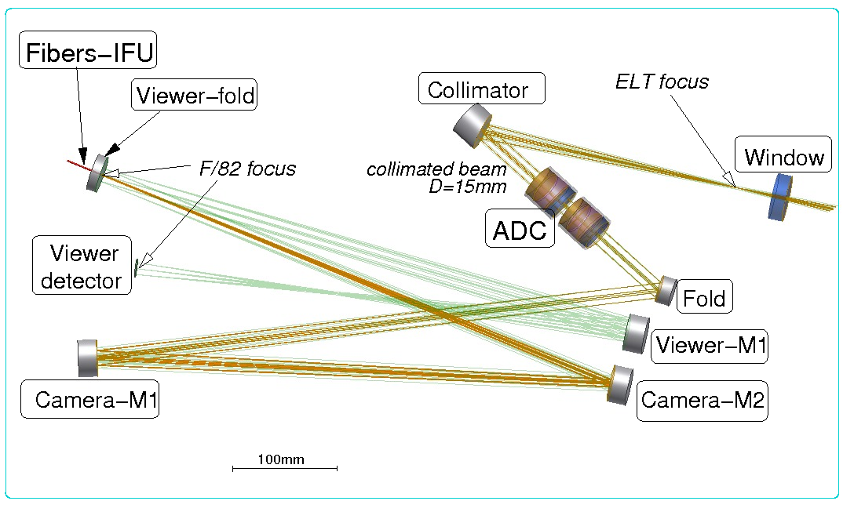
HIRES: IFU interface
D_{fiber}(IFU) = 0.11mm
D_{bundle}(IFU) = 0.77mm

Slide 28
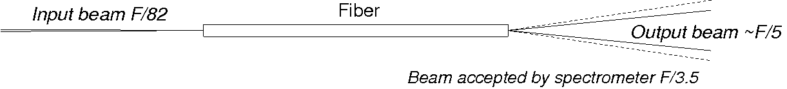
HIRES: IFU, scale change and diffraction limit
Change of scale is obtained by feeding fibers with a slower beam
Nothing is changed in the spectrometer
Spectrometer is oversized, it works with a shrunk pupil image
Effective size of pupil image depends on fibers FRD
  pupil diameter is much larger than in geometric optics
  spectrometer does not work in diffraction-limit mode
→ Fibers focal ratio degradation helps to get better image quality (!)

Slide 29
HIRES: fibers transmission and positioning of modules
This part

Slide 30
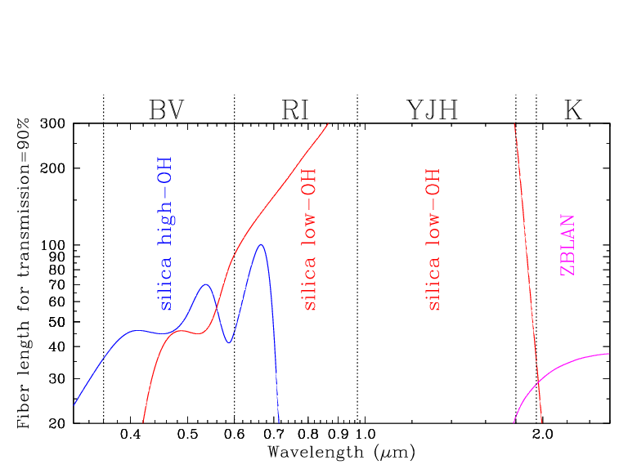
HIRES: fibers transmission and positioning of modules
Far from
platform
Nas-platform
Anywhere
Nas-platform

Slide 31
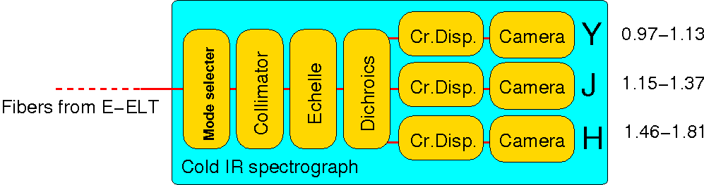
HIRES cross-dispersed spectral format
Same format for all observing modes
H 1.45-1.81 μm
orders 74-93
J 1.16-1.38 μm
orders 99-119
Y 0.97-1.14 μm
orders 118-140

Slide 32
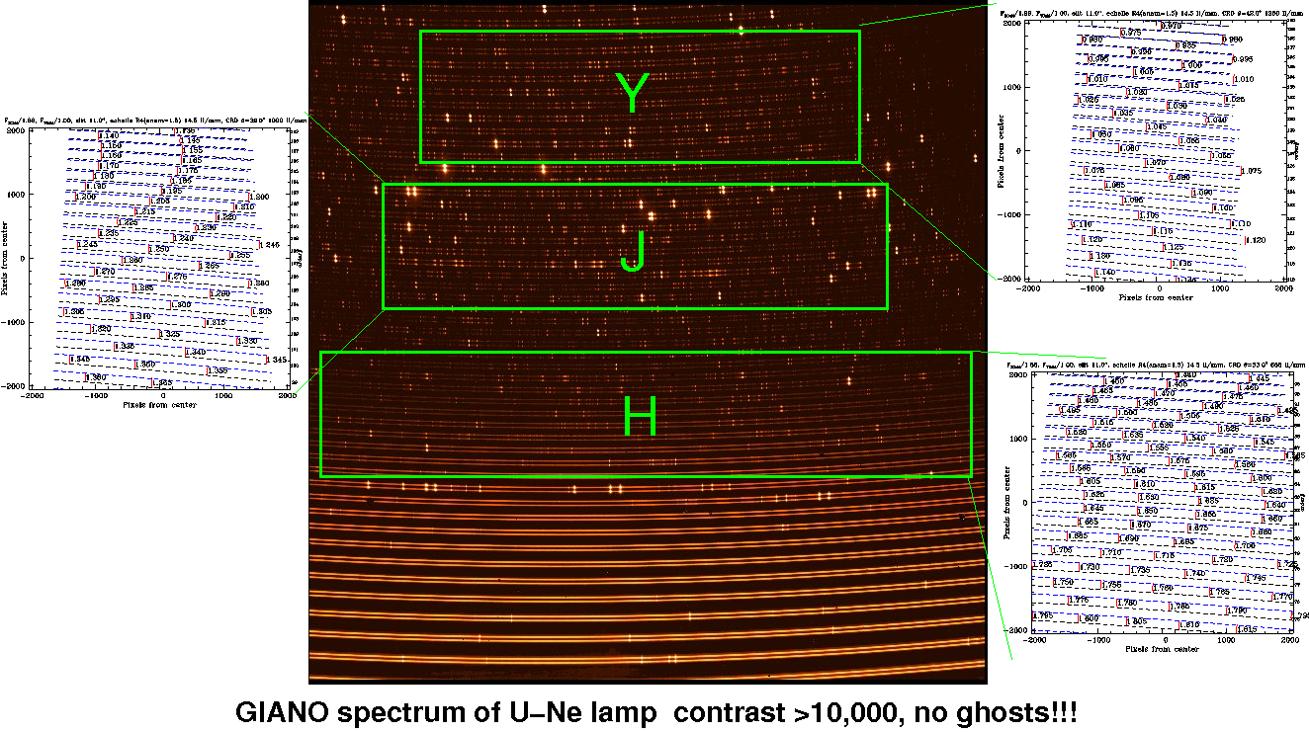
HIRES cross-dispersed spectral format
Slit too long for full spectral coverage with 1 channel

Slide 33
HIRES comparison R4-R6
Illumination of input slit

Slide 34
HIRES comparison R6 – R4
R6: no anamorphics magnification before echelle

Slide 35
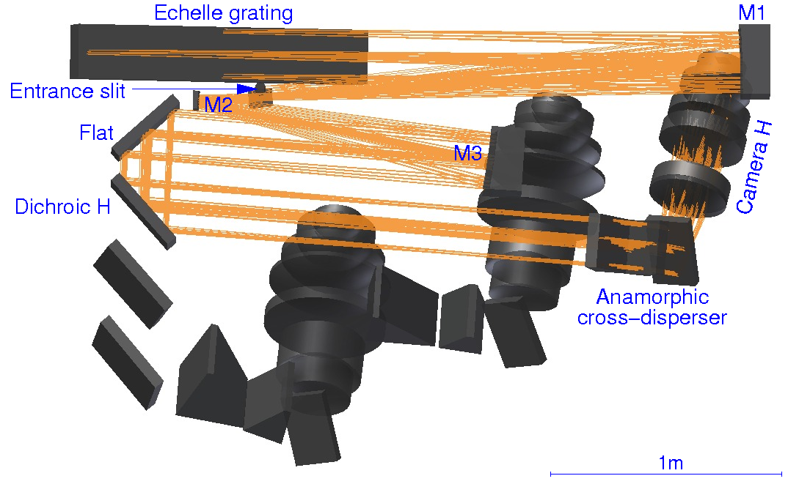
HIRES with R4 echelle (H-band)
200mm collimated beam
R64 1.5 x anamorphic magnification before echelle

Slide 36
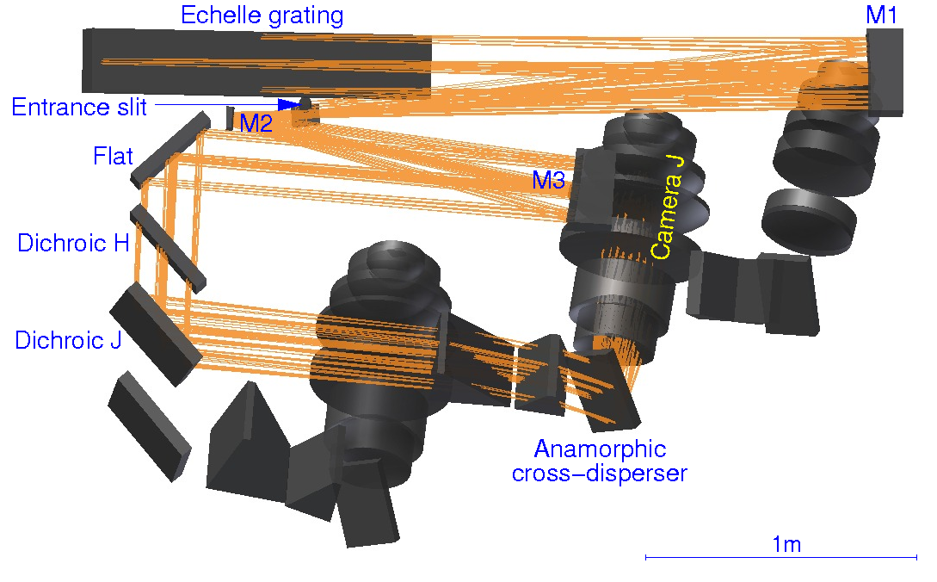
HIRES with R4 echelle (J-band)
200mm collimated beam
R64 1.5 x anamorphic magnification before echelle

Slide 37
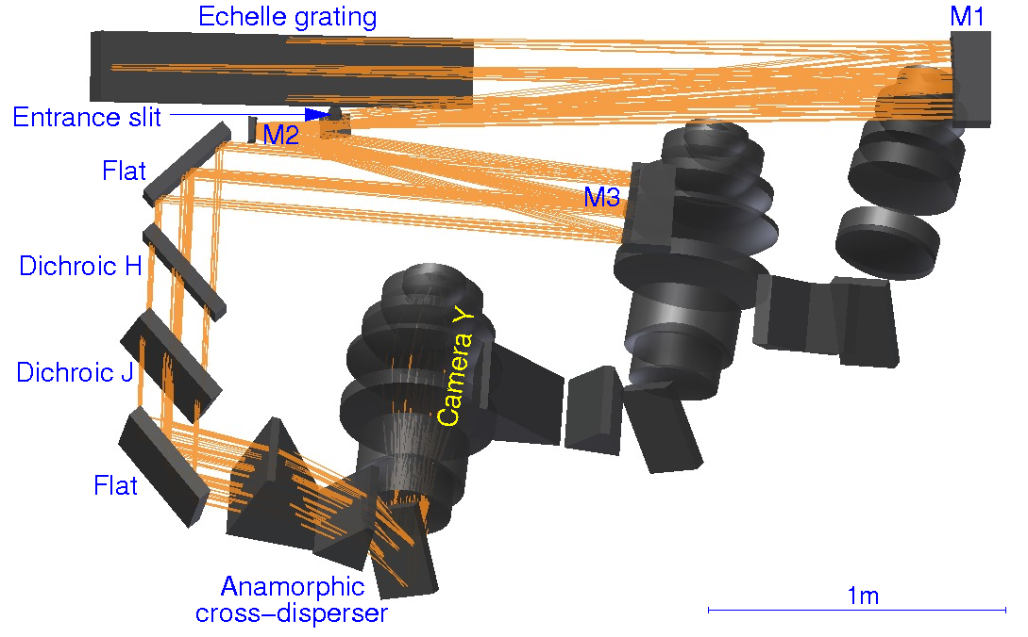
HIRES with R4 echelle (Y-band)
200mm collimated beam
R64 1.5 x anamorphic magnification before echelle

